Slide 1
Docker Compose
A multi-purpose tool

Slide 2

Why Docker
Code
Third party libraries
OS Libraries
Resources
Configuration Settings

Slide 3
Why Docker
No more “it works only on my machine”
No technology or infrastructure lock-in
Reduces time to bring applications to market
Tool for both Developers + Operations (DevOps)
Operating system-level virtualization
Open-source

Slide 4
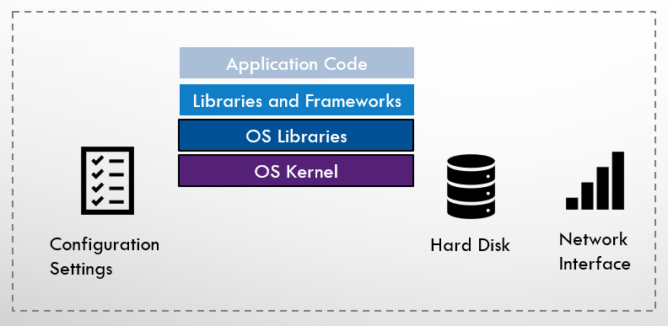
What is Docker?
Tool: Create, Deploy and Run applications in Containers

Slide 5
Docker Images & Containers
Docker Images
Executable package of software
Lightweight
Standalone/Isolated
Immutable
Portable
Secure
Docker Containers
Standardized unit of software
Abstraction
Development
Shipping
Deployment
Disposable
Containers spun in seconds (fraction)
Less time b/w writing the code and running it in production

Slide 6
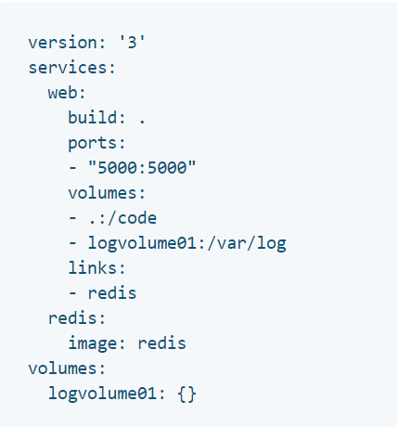
Docker Compose
docker-compose.yml
Tool for running multi-container Docker applications
Steps:
docker-compose.yml: define services
docker-compose up
Docker compose version: 3.7
Docker Engine: 18.06.0+

